Slide 1
Two-Way
Analysis of Variance
Chapter 11
Chap 11-<number>

Slide 2
Learning Objectives
In this chapter, you learn:
How to use two-way analysis of variance and interpret the interaction effect
How to perform multiple comparisons in a two-way analysis of variance
Chap 11-<number>

Slide 3
Factorial Design:
Two-Way ANOVA
Examines the effect of
  Two factors of interest on the dependent variable
    e.g., Percent carbonation and line speed on soft drink bottling process
  Interaction between the different levels of these two factors
    e.g., Does the effect of one particular carbonation level depend on which level the line speed is set?

Slide 4
Two-Way ANOVA
(continued)
Assumptions
  Populations are normally distributed
  Populations have equal variances
  Independent random samples are drawn
Chap 11-<number>

Slide 5
Two-Way ANOVA
Sources of Variation
Two Factors of interest: A and B
r = number of levels of factor A
c = number of levels of factor B
n’ = number of replications for each cell
n = total number of observations in all cells n = (r)(c)(n’)
X_{ijk} = value of the k^{th} observation of level i of factor A and level j of factor B
Chap 11-<number>

Slide 6
Two-Way ANOVA
Sources of Variation
(continued)
SST = SSA + SSB + SSAB + SSE
Degrees of Freedom:
SSA
Factor A Variation
r – 1
SST
Total Variation
SSB
Factor B Variation
c – 1
SSAB
Variation due to interaction
between A and B
(r – 1)(c – 1)
n - 1
SSE
Random variation (Error)
rc(n’ – 1)
Chap 11-<number>

Slide 7
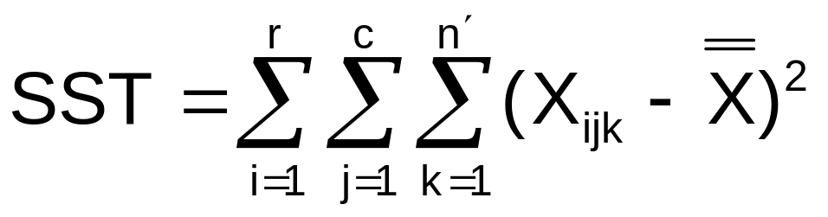
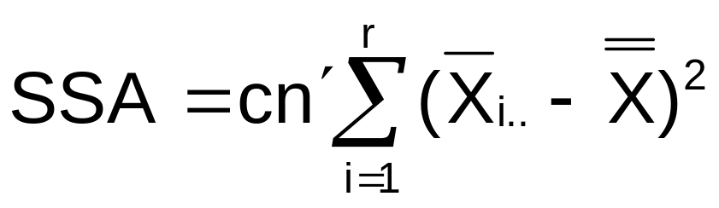
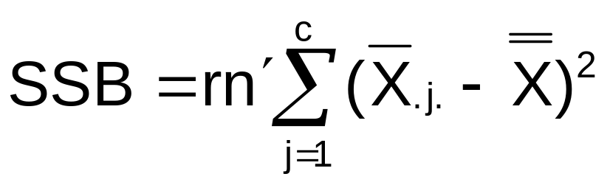
Two-Way ANOVA Equations
Total Variation:
Factor A Variation:
Factor B Variation:
Chap 11-<number>

Slide 8
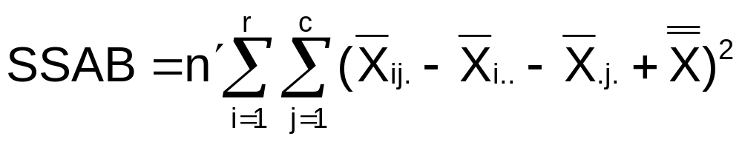
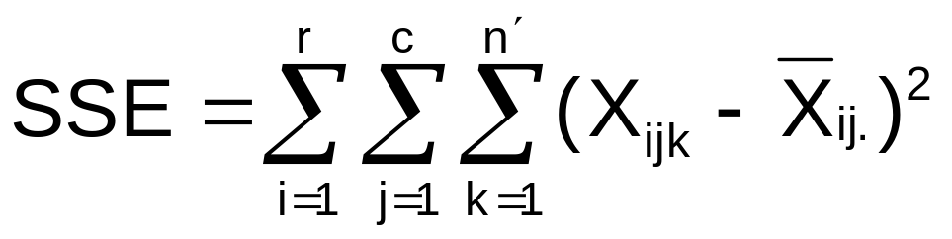
Two-Way ANOVA Equations
(continued)
Interaction Variation:
Error Sum of Squares:
Chap 11-<number>

Slide 9
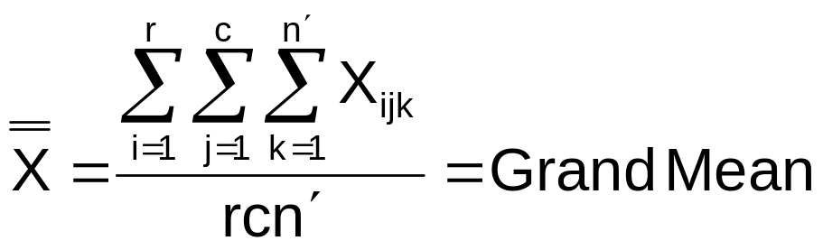
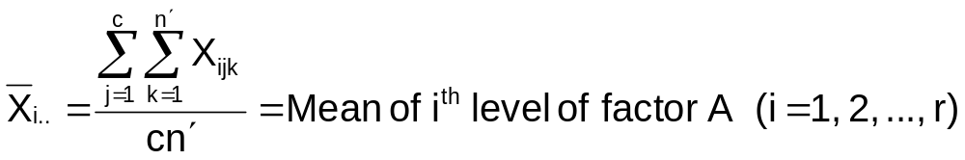
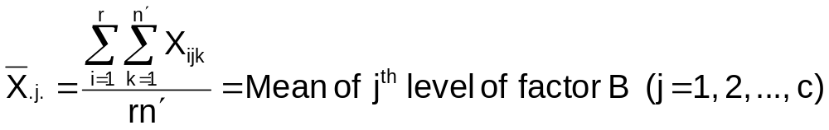
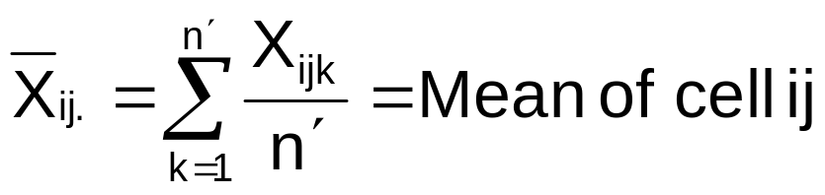
Two-Way ANOVA Equations
(continued)
where:
r = number of levels of factor A
c = number of levels of factor B
n’ = number of replications in each cell
Chap 11-<number>

Slide 10
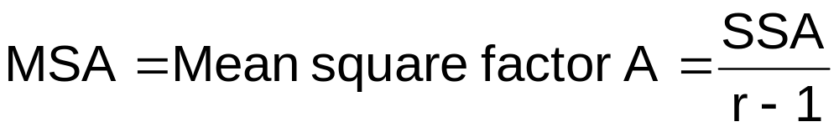
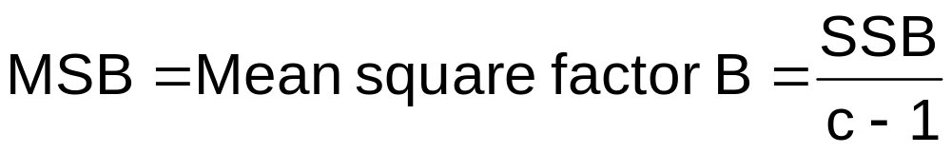
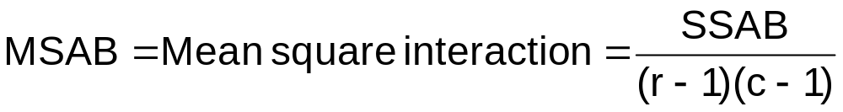
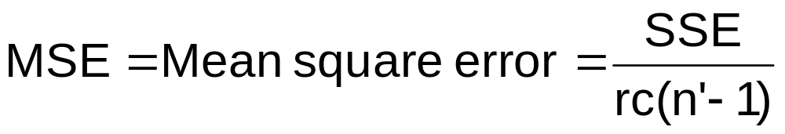
Mean Square Calculations
Chap 11-<number>

Slide 11
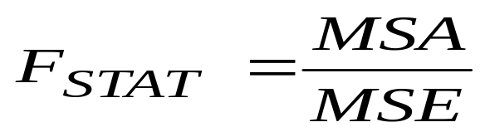
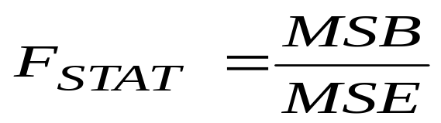
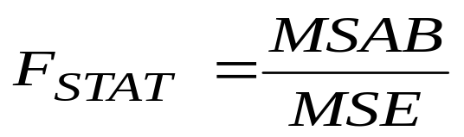
Two-Way ANOVA:
The F Test Statistics
F Test for Factor A Effect
H₀: μ_{1..}= μ_{2..} = μ_{3..}= • • = µ_{r..}
H₁: Not all μ_{i..} are equal
Reject H₀ if F_{STAT} > F_{α}
F Test for Factor B Effect
H₀: μ_{.1.} = μ_{.2.} = μ_{.3.}= • • = µ_{.c.}
H₁: Not all μ_{.j.} are equal
Reject H₀ if F_{STAT} > F_{α}
F Test for Interaction Effect
H₀: the interaction of A and B is equal to zero
H₁: interaction of A and B is not zero
Reject H₀ if F_{STAT} > F_{α}
Chap 11-<number>

Slide 12
Two-Way ANOVA
Summary Table
Source of Variation | Sum of Squares | Degrees of Freedom | Mean Squares | F
Factor A | SSA | r – 1 | MSA = SSA /(r – 1) | MSA MSE
Factor B | SSB | c – 1 | MSB = SSB /(c – 1) | MSB MSE
AB (Interaction) | SSAB | (r – 1)(c – 1) | MSAB = SSAB / (r – 1)(c – 1) | MSAB MSE
Error | SSE | rc(n’ – 1) | MSE = SSE/rc(n’ – 1)
Total | SST | n – 1
Chap 11-<number>

Slide 13
Features of Two-Way ANOVA
F Test
Degrees of freedom always add up
  n-1 = (r-1) + (c-1) + (r-1)(c-1) + rc(n’-1)
  Total = factor A + factor B + interaction + error
The denominators of the F Test are always the same but the numerators are different
The sums of squares always add up
  SST = SSA + SSB + SSAB + SSE
  Total = factor A + factor B + interaction + error
Chap 11-<number>

Slide 14
Examples
## 11.15 – 11.18
# 11.19
# 11.20
Chap 11-<number>

Slide 15
Examples:
Interaction vs. No Interaction
Interaction is present: some line segments not parallel
No interaction: line segments are parallel
Factor B Level 1
Factor B Level 1
Factor B Level 3
Mean Response
Mean Response
Factor B Level 2
Factor B Level 2
Factor B Level 3
Factor A Levels
Factor A Levels
Chap 11-<number>

Slide 16
Do ACT Prep Course Type & Length Impact Average ACT Scores
ACT Scores for Different Types and Lengths of Courses
 | LENGTH OF COURSE
TYPE OF COURSE | Condensed |  | Regular
Traditional | 26 | 18 | 34 | 28
Traditional | 27 | 24 | 24 | 21
Traditional | 25 | 19 | 35 | 23
Traditional | 21 | 20 | 31 | 29
Traditional | 21 | 18 | 28 | 26
Online | 27 | 21 | 24 | 21
Online | 29 | 32 | 16 | 19
Online | 30 | 20 | 22 | 19
Online | 24 | 28 | 20 | 24
Online | 30 | 29 | 23 | 25
Chap 11-<number>

Slide 17
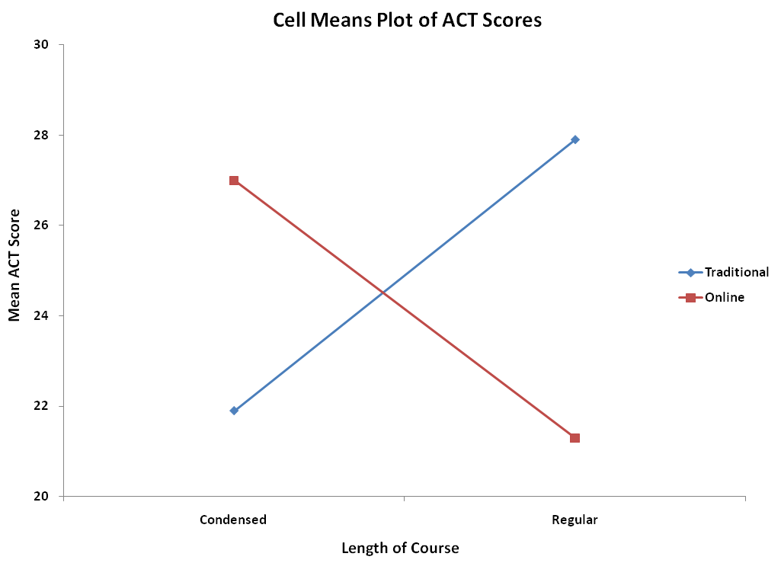
Plotting Cell Means Shows A Strong Interaction
Nonparallel lines indicate
the effect of condensing
the course depends on
whether the course is
taught in the traditional
classroom or by online
distance learning
The online course yields higher scores when condensed while the traditional course yields higher scores when not condensed (regular).
Chap 11-<number>

Slide 18
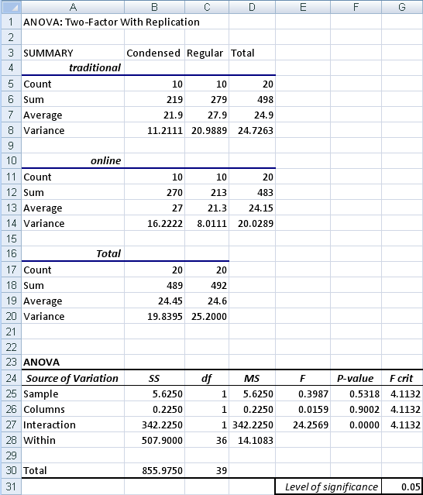
Excel Analysis Of ACT Prep Course Data
The interaction between course
length & type is significant
because its p-value is 0.0000.
While the p-values associated
with both course length &
course type are not significant,
because the interaction is
significant you cannot directly
conclude they have no effect.
Chap 11-<number>

Slide 19
What to do if interaction is present?
When there is significant interaction, we can collapse the data into 4 groups –
  Traditional course condensed
  Traditional course regular length
  Online course condensed
  Online course regular length
After collapsing into four groups do a one way ANOVA
Chap 11-<number>

Slide 20
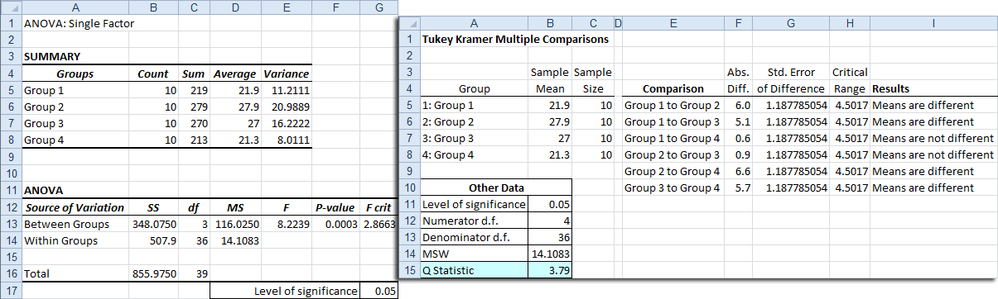
Excel Analysis Of Collapsed Data
Traditional regular > Traditional condensed
Online condensed > Traditional condensed
Traditional regular > Online regular
Online condensed > Online regular
If the course is take online should use the
condensed version and if the course is taken
by traditional method should use the regular.
Group is a significant effect.
p-value of 0.0003 < 0.05
Chap 11-<number>

Slide 21
Chapter Summary
In this chapter we discussed
The two-way analysis of variance
  Examined effects of multiple factors
  Examined interaction between factors
Chap 11-<number>

Slide 22
Examples
# 11.22
## 11.24, 11.26 (in Excel, data analysis toolpak, choose “ANOVA: two-factor with replication”)
Chap 11-<number>

